Slide 1
EmuLadder:
Daniel Frye, Gabriel Wilmoth, Mckenzie Moize, Rinty Chowdhury, Robert Meyer

Slide 2
Wireframe

Slide 3
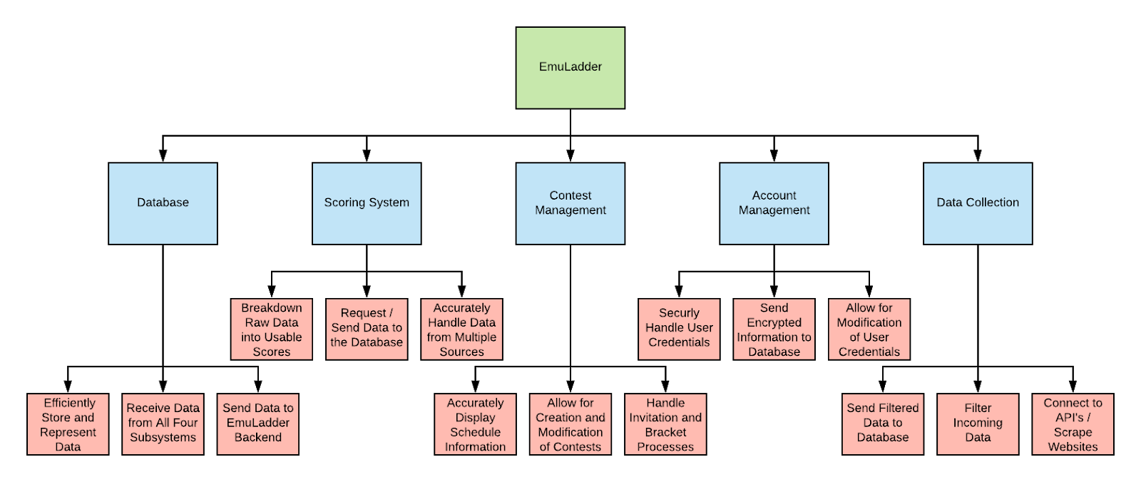
Top-Down Diagram

Slide 4
Sub-Systems
In our subsystems: Database, Scoring System, Contest Management, Account Management, and Data Collection are divided into separate sub-processes that take place within each subsystem. Such as:
Database: Store and Represent Data, Receive Data from subsystems and Send Data to backend of the system
Scoring System: Process raw data ,Request and send Data to Database and Handles Data from multiple sources
Contest Management: Display Schedule information, Allow creation of and updates of Contests and Invitation and Bracket processes
Account Management: Security and user credential handling, Sends Encrypted information to Database, Allows Modification of user credentials.
Data Collection: Sends filtered data to Database, Filter incoming data and Connect with API(s)

Slide 5
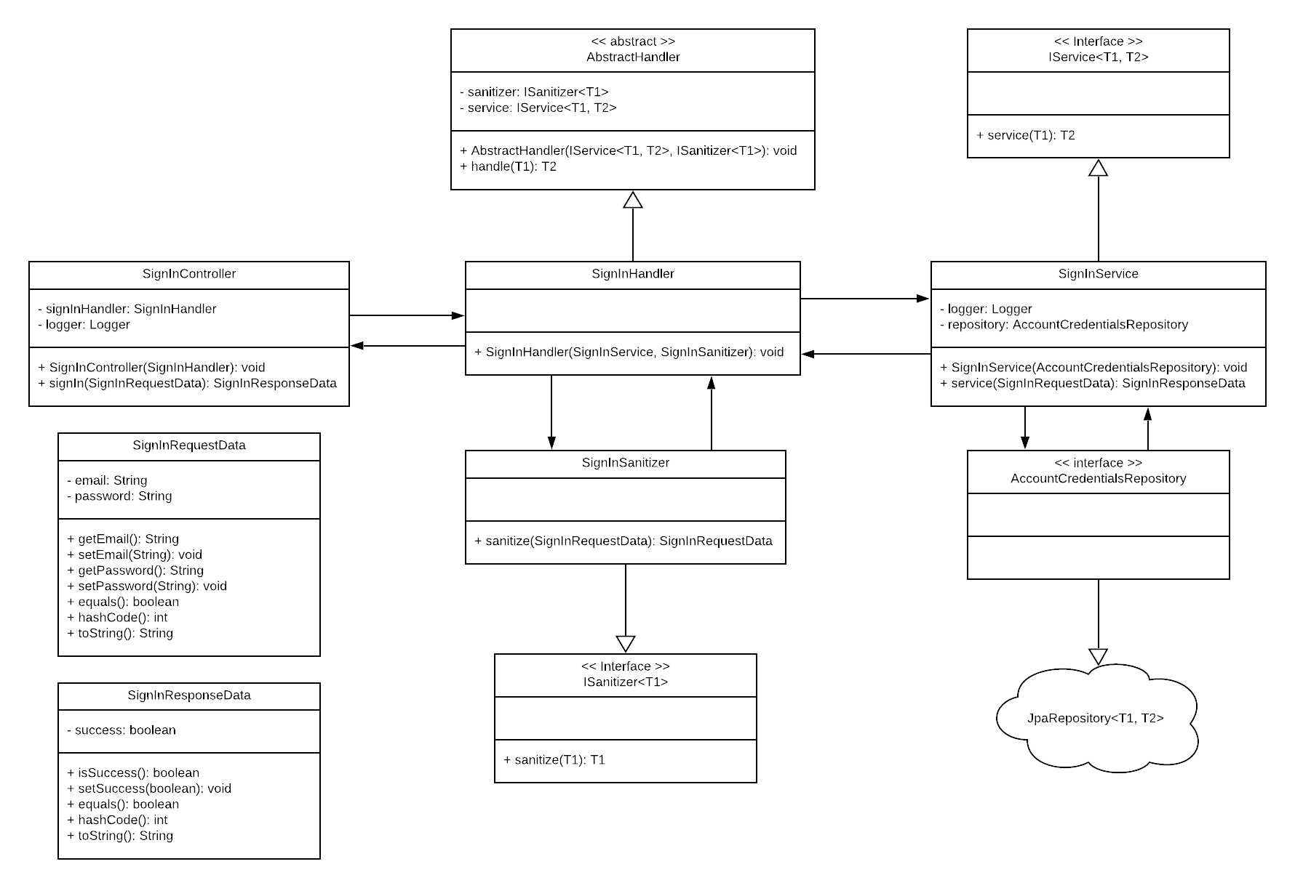
Class Diagram

Slide 6
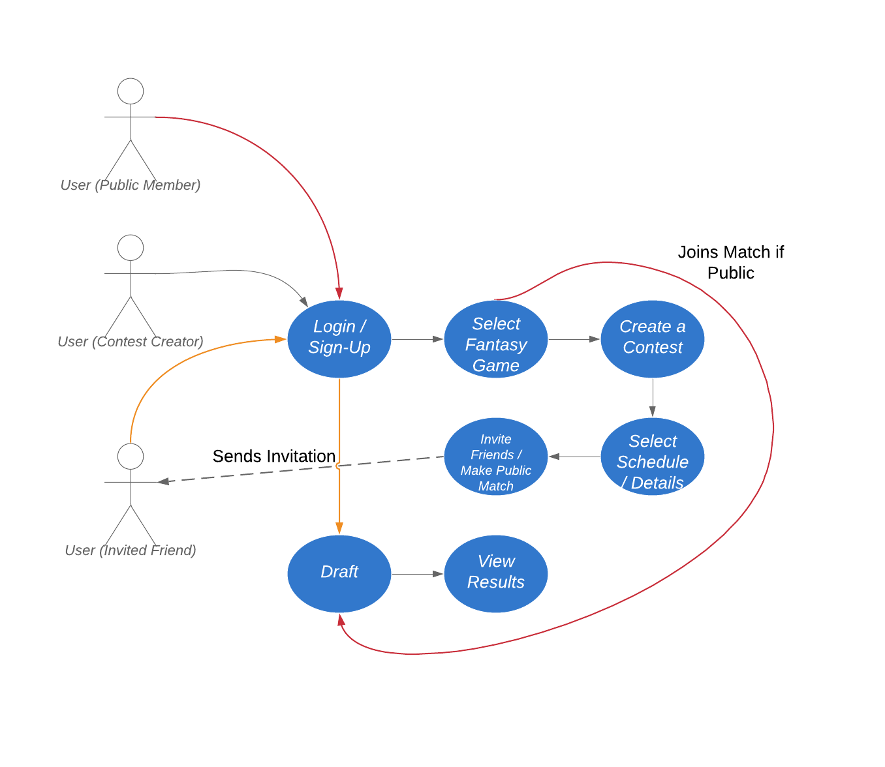
Use-Case Diagram

Slide 7
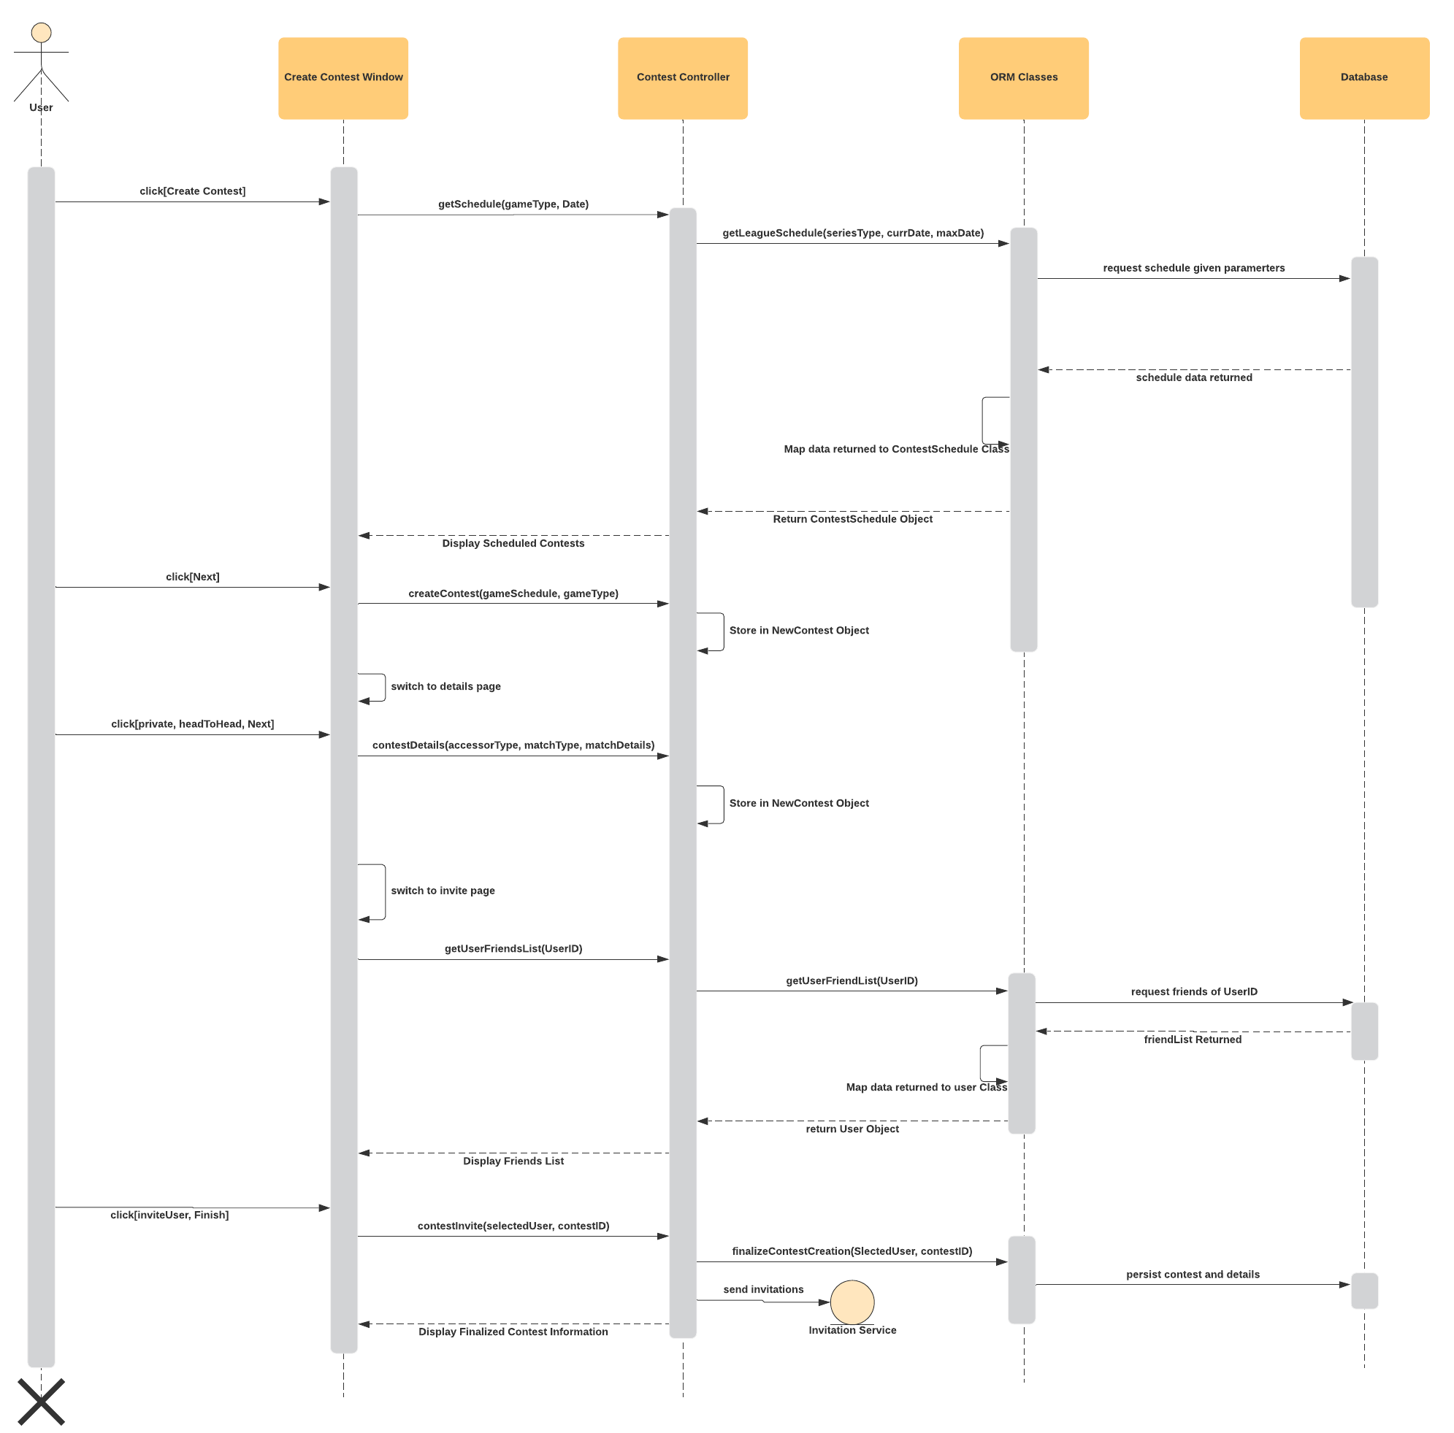
Sequence Diagram

Slide 8
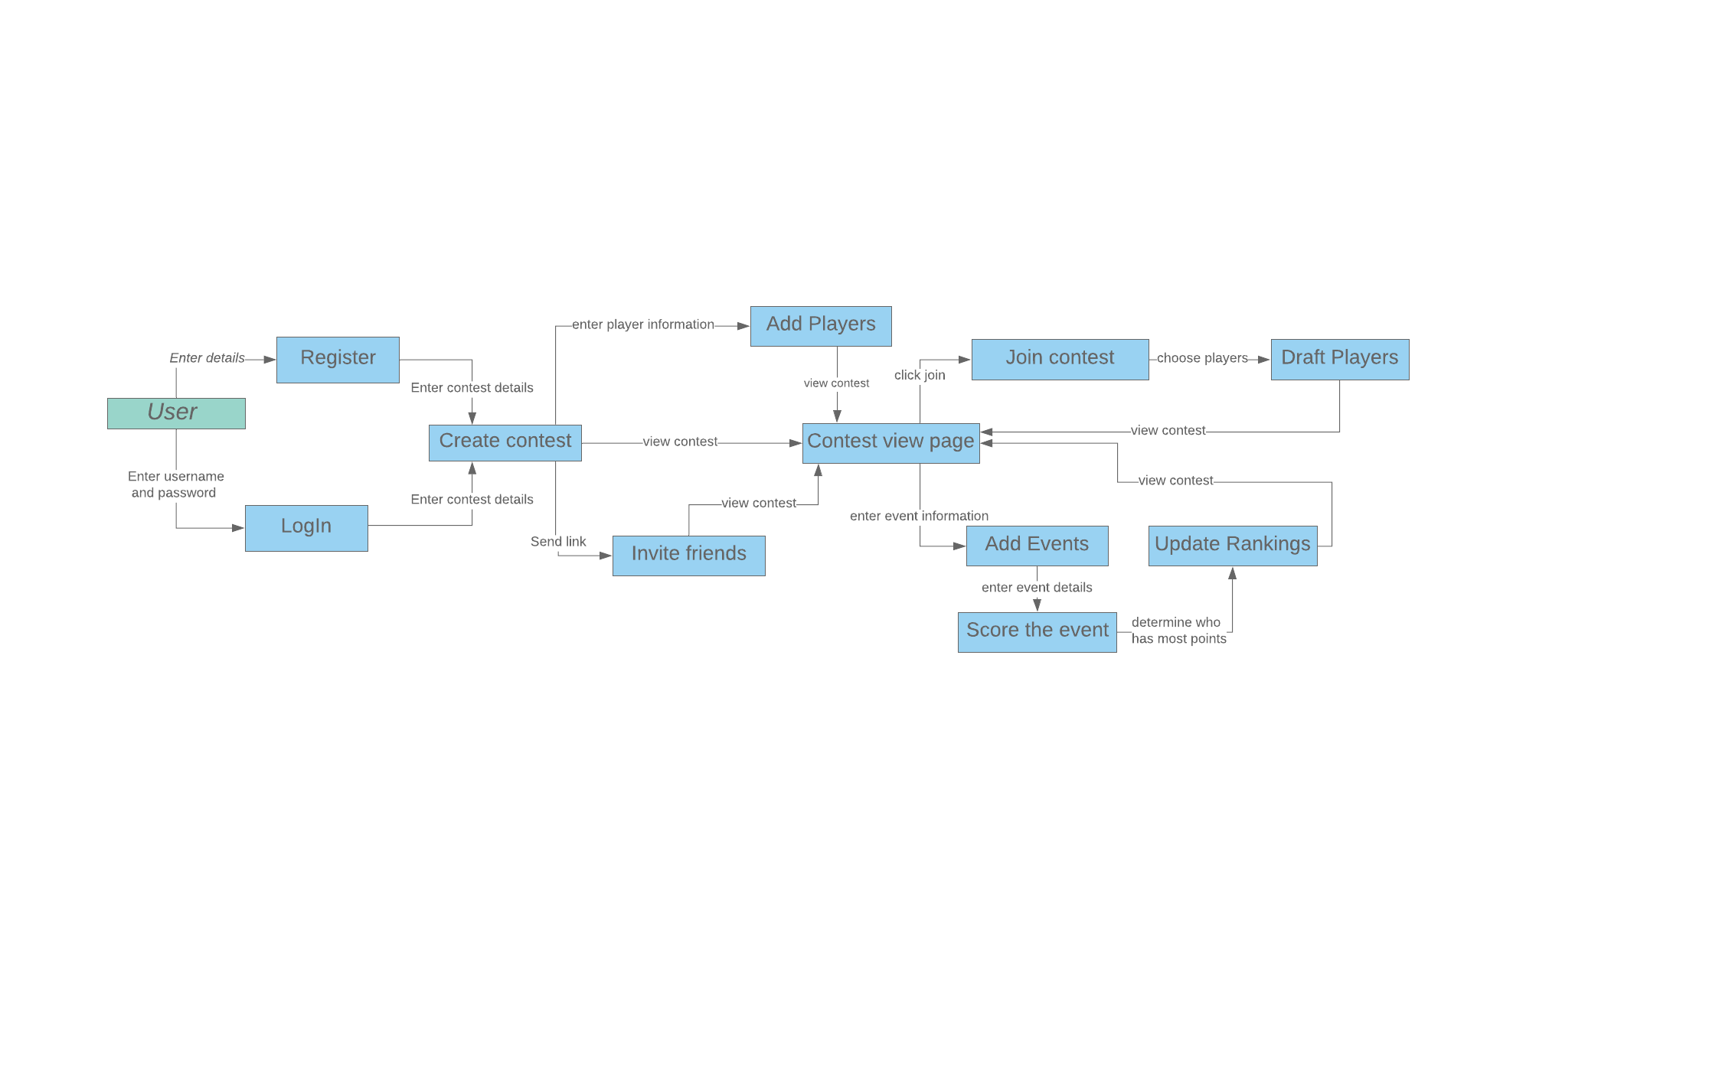
Data Flow Diagram
Notes:
Rinty

Slide 9
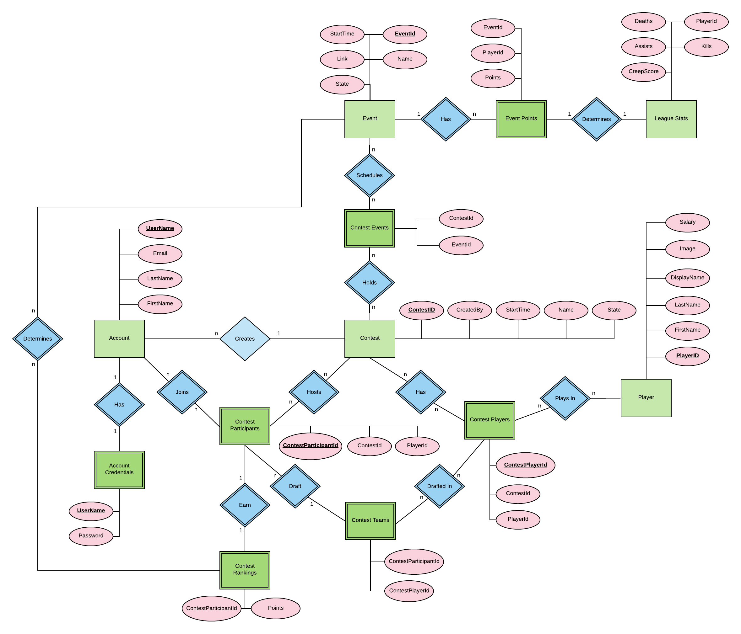
E-R Model

Slide 10
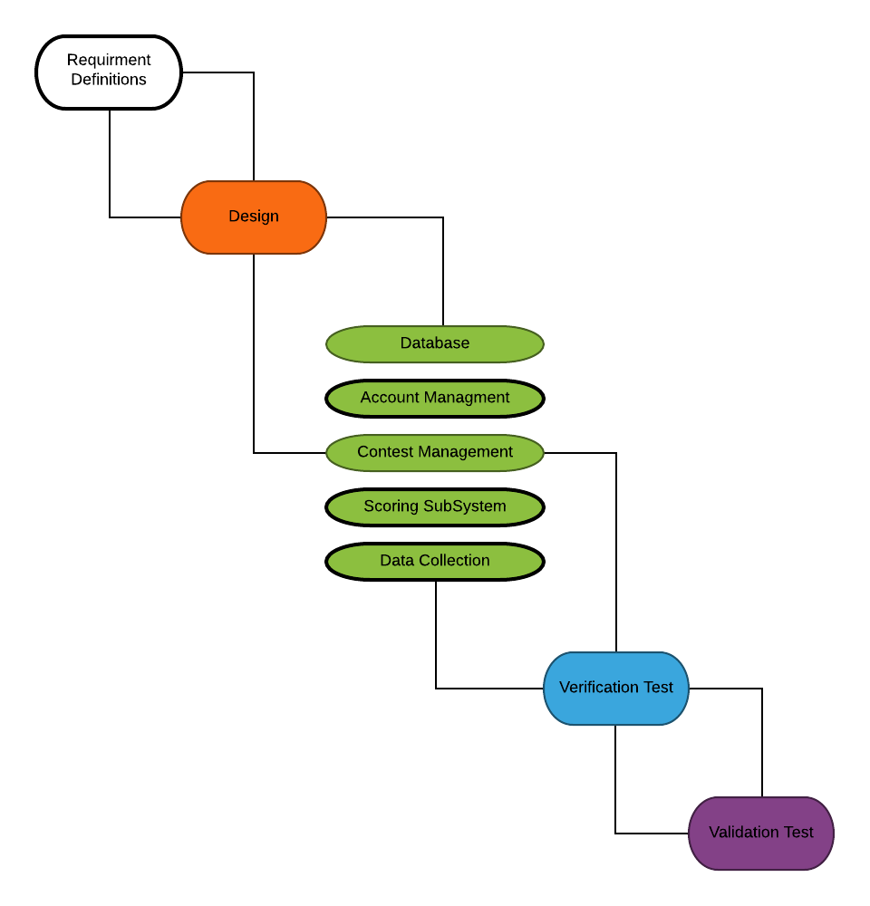
Process Model
Notes:
~A visual description of how the tentative development process will come together.
-Verification test: test cases
-Validation test: bug testing

Slide 11
Algorithm Analysis of Sub-Systems
Scoring O(n)
Adding points up for scores O(n)
Adding points to ranking O(n)
Contest Management O(n):
Creating contests O(1)
Modifying contests O(1)
Inviting friends to contests O(1)
Adding players to a contest O(n)
Drafting Players O(n)
Account Management O(1):
Creating an account O(1)
Logging into account O(1)
Editing an account O(1)
Signing up for contests O(1)
Account recovery O(1)
Data Collection O(n)
Retrieving JSON from API O(1)
Converting JSON to database object notation O(n)
Database O(n):
Creating tables O(1)
Editing tables O(1)
Deleting tables O(1)
Getting information from tables O(1)
Updating tables for all users O(n)

Slide 12
Algorithm Analysis of System
emuLadder O(n)
Scoring O(n)
Contest Management O(n)
Account Management O(1)
Data Collection O(n)
Database O(n)

